Slide 1

McGraw-Hill Technology Education
Copyright © 2006 by The McGraw-Hill Companies, Inc. All rights reserved.

Slide 2
Chapter 6A
Types of Storage Devices
Notes:
Teaching tip
A good warm-up to storage devices is to discuss the time before we could save items on disk. Discuss the perils of typing papers on a typewriter. Then contrast with the simplicity of saving to disk.

Slide 3
Describing Storage Devices
Store data when computer is off
Two processes
  Writing data
  Reading data

Slide 4
Describing Storage Devices
Storage terms
  Media is the material storing data
  Storage devices manage the media
  Magnetic devices use a magnet
  Optical devices use lasers
  Solid-state devices have physical switches

Slide 5
Magnetic Storage Devices
Most common form of storage
Hard drives, floppy drives, tape
All magnetic drives work the same
Notes:
Teaching tip
Figure 6A.2 and 6A.3 on page 227 provide illustrations of devices and the read/write process.

Slide 6
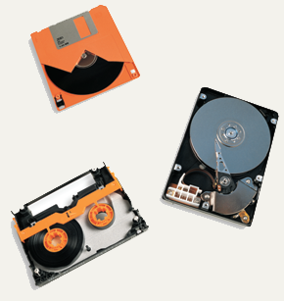
Magnetic Storage Devices
Floppy Disk
Hard Disk
Tape

Slide 7
Magnetic Storage Devices
Data storage and retrieval
  Media is covered with iron oxide
  Read/write head is a magnet
  Magnet writes charges on the media
    Positive charge is a 1
    Negative charge is a 0
  Magnet reads charges
  Drive converts charges into binary
Notes:
Teaching tip
This process is difficult for students to see. Draw a diagram on the board that illustrates the process.

Slide 8
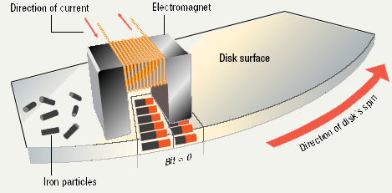
Data Retrieval

Slide 9
Magnetic Storage Devices
Data organization
  Disks must be formatted before use
  Format draws tracks on the disk
  Tracks is divided into sectors
    Amount of data a drive can read
Notes:
Discussion point
Discuss the sector size limitation. Discuss what can happen when writing a 1-byte file or a 513-byte file. After the waste issue is brought up, then discuss the problem from the hardware issue. How can a manufacturer make a 1-byte head?

Slide 10
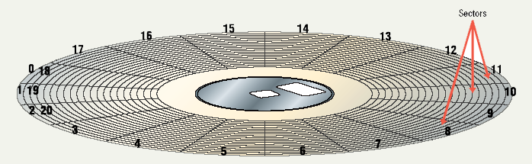
Tracks and Sectors

Slide 11
Magnetic Storage Devices
Finding data on disk
  Each track and sector is labeled
    Some are reserved
  Listing of where files are stored
    File Allocation Table (FAT)
    FAT32
    NTFS
  Data is organized in clusters
    Size of data the OS handles
Notes:
Teaching tip
Draw clustering on the board. Discuss why it can improve the performance of a system.

Slide 12
Magnetic Storage Devices
Diskettes
  Also known as floppy disks
  Read with a disk drive
  Mylar disk
  Spin at 300 RPM
  Takes .2 second to find data
  3 ½ floppy disk holds 1.44 MB
Notes:
Teaching tip
The formula for the disk capacity is listed on page 232 of the text.

Slide 13
Magnetic Storage Devices
Hard disks
  Primary storage device in a computer
  2 or more aluminum platters
  Each platter has 2 sides
  Spin between 5,400 to 15,000 RPM
  Data found in 9.5 ms or less
  Drive capacity greater than 40 GB
Notes:
Teaching tip
Students often have a hard time grasping the speed of a hard drive. Use an analogy: The circumference of a hard drive platter is nearly 1 foot. A drive spinning 5,400 RPM can travel 5,400 feet in one minute, or a little over 1 mile in a minute!

Slide 14
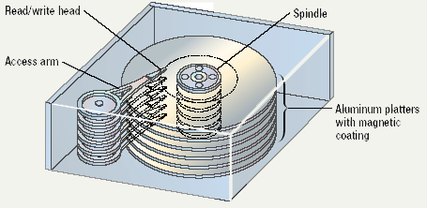
Illustrated Hard Disk

Slide 15
Magnetic Storage Devices
Removable high capacity disks
  Speed of hard disk
  Portability of floppy disk
  Several variants have emerged
  High capacity floppy disk
    Stores up to 750 MB of data
  Hot swappable hard disks
    Provide GB of data
    Connect via USB

Slide 16
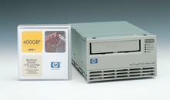
Magnetic Storage Devices
Tape drives
  Best used for
    Infrequently accessed data
    Back-up solutions
  Slow sequential access
  Capacity exceeds 200 GB
Notes:
Teaching tip
Students often do not understand why random access hard drives and floppy drives are faster than sequential drives. To illustrate, compare the modern audio CD to the antiquated 8-track. On a CD if you wish to hear song 1 over and over, you simply press repeat. In an 8-track, you often must play the entire tape before the song can be repeated.

Slide 17
Optical Storage Devices
CD-ROM
  Most software ships on a CD
  Read using a laser
    Lands, binary 1, reflect data
    Pits scatter data
  Written from the inside out
  CD speed is based on the original
    Original CD read 150 Kbps
    A 10 X will read 1,500 Kbps
  Standard CD holds 650 MB

Slide 18
Optical Storage Devices
DVD-ROM
  Digital Video Disk
  Use both sides of the disk
  Capacities can reach 18 GB
  DVD players can read CDs

Slide 19
Recordable Optical Technologies
CD Recordable (CD-R)
  Create a data or audio CD
  Data cannot be changed
  Can continue adding until full

Slide 20
Recordable Optical Technologies
CD Regrettable (CD-RW)
  Create a reusable CD
  Cannot be read in all CD players
  Can reuse about 100 times
Notes:
Insider Information
When a CD-R or RW is ‘burned’, the laser modifies the reflectivity of a dye that is sandwiched between the bottom clear layer and a top reflective layer. The lands are transparent sections while the pits are non-reflective.

Slide 21
Recordable Optical Technologies
Photo CD
  Developed by Kodak
  Provides for photo storage
  Photos added to CD until full
  Original pictures cannot be changed

Slide 22
Recordable Optical Technologies
DVD Recordable
  Several different formats exist
  None are standardized
  Allows home users to create DVDs
  Cannot be read in all players
Notes:
Teaching tip
There are several formats of DVD recordable. Current research indicates that DVD+R is more compatible with devices than the other formats. Spend time researching the different standards.

Slide 23
Recordable Optical Technologies
DVD-RAM
  Allow reusing of DVD media
  Not standardized
  Cannot be read in all players

Slide 24
Solid State Devices
Data is stored physically
No magnets or laser
Very fast

Slide 25
Solid State Devices
Flash memory
  Found in cameras and USB drives
  Combination of RAM and ROM
  Long term updateable storage

Slide 26
Solid State Devices
Smart cards
  Credit cards with a chip
  Chip stores data
  Eventually may be used for cash
  Hotels use for electronic keys

Slide 27
Solid State Devices
Solid-state disks
  Large amount of SDRAM
  Extremely fast
  Volatile storage
  Require battery backups
  Most have hard disks copying data

Slide 28
Chapter 6A
End of Chapter
Notes:
Teaching tip
A good warm-up to storage devices is to discuss the time before we could save items on disk. Discuss the perils of typing papers on a typewriter. Then contrast with the simplicity of saving to disk.

